Slide 1
Messaging System
In
Online Ordering.
Manoj Kumar Gorla
2016HW86252

Slide 2
What is Messaging Queue
Asynchronous service to service communication used in Server less
And Micro services to Architectures .

Slide 3
It can be done in either online ordering or offline going to shop.
Shop
Online
Offline

Slide 4
Customer-3
send
send
Customer -1
Shop
Customer-2
Receive
Receive
Customer -4

Slide 5
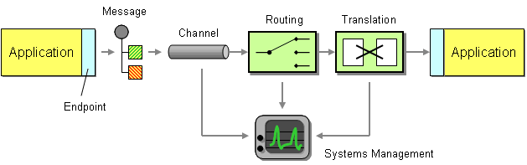
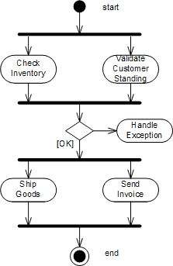

Slide 6
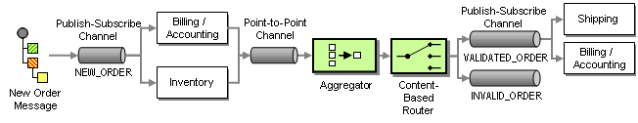
Once Customer orders in online before the order is sending to the shop .
The message will be processed, Filtered ,segregated and finally it will send the order to the shop.

Slide 7
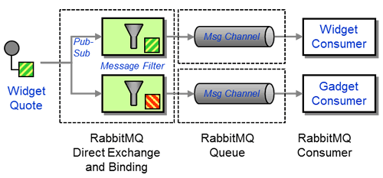
By using filters we will segregate the order
we use a Publish-Subscribe Channel to implement the fork action and an Aggregator to implement the join action. A Publish-Subscribe Channel sends a message to all active consumers while an Aggregator receives multiple incoming messages and combines them into a single

Slide 8
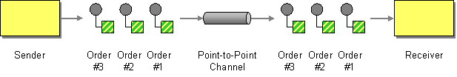
the intent of messages on the Point-to-Point Channels between the Content-Based Router and the inventory systems is different from the previous channel. These channels contain Command Messages, messages that instruct the system to execute the specified command.

Slide 9
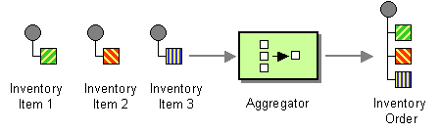
Aggregator
The Aggregator is a special Filter that receives a stream of messages and identifies messages that are correlated. Once a complete set of messages has been received (more on how to decide when a set is 'complete' below), the Aggregator collects information from each correlated message and publishes a single, aggregated message to the output channel for further processing.
the Content-Based Router forwards the message to the VALIDATED_ORDER channel. If the customer is not in good standing or we have no inventory on hand, it forwards the message to the INVALID_ORDER process.

Slide 10
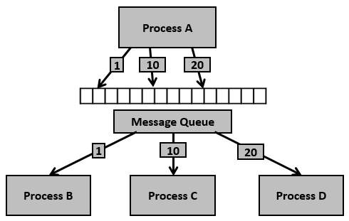

Slide 11
Once the request receives in the shop it will processed based on the priority using messaging system it will assign in the Queue and the data will be store in data base.
Shop - 1
Shop - 2
Shop - 3
Ser - 1
Ser – 2
Ser - 3
Data base

Slide 12
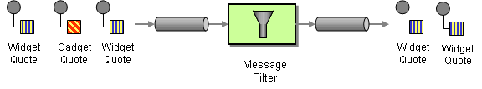
Once the order receives then ,the Load balancer will assign the orders to the server with the help of filters
ID | List | Delivered | Server-ID
1 | cooldrinks | Yes | Ser-1
2 | Groceries | NO | Ser-2
3 | mobile | Yes | Ser-3
4 | wallet | NO | Ser-1
5 | cloths | yes | Ser-2
Multiple Customers
Multiple Suppliers

Slide 13
Ser - 1
Orders
1,4
Notifier
Ser - 2
Load balancer
2,5
Ser – 3
3
Data Base

Slide 14
Notifer : It will check the heart beat of the server before assigning the
order to the server. If it didn’t receives any response from server
then it will assign the task/order to another server.
Notifier will check heart beat for every 10 -15 sec interval.
Load balancer : balancing refers to efficiently distributing incoming network traffic across a group of backend servers, also known as a server farm or server pool. ... In this manner, a load balancer performs the following functions: Distributes client requests or network load efficiently across multiple servers.
In that way, The Load balancer will maintain the balance in server and also will not allow duplicate orders to server.

Slide 15
EX: If server 3 - get failed/Crashed then with the help of Load balancer we can assign the Server 3 orders to either server 1 or server 2
At the end of the queue based on Priority.
With the help of notifer, Load balancer and hear beat we can encapsulate all the complex into single task and the work will be done.

Slide 16
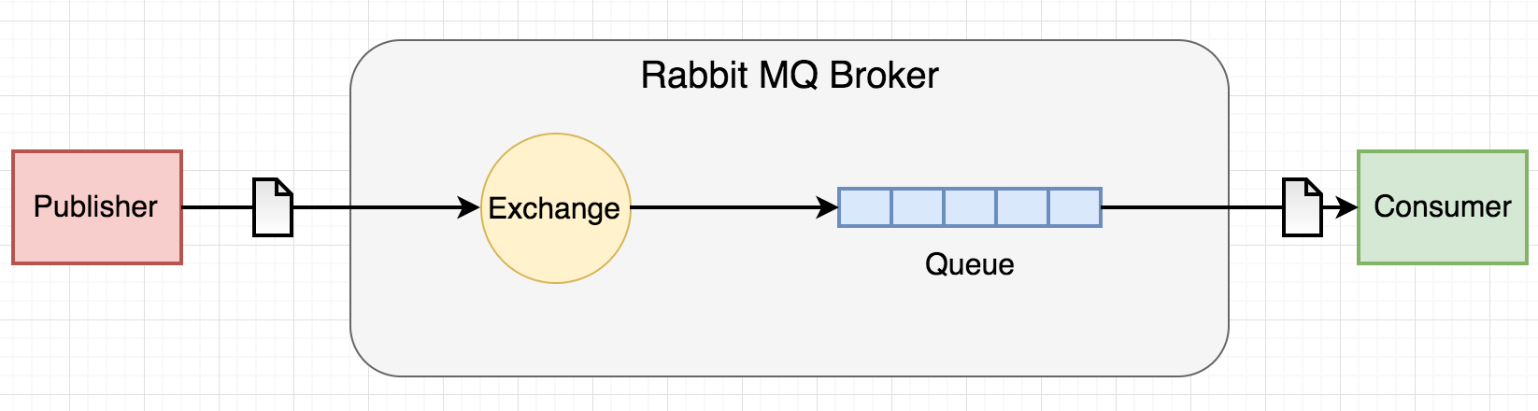
The best example for Message queus is
Rabbitmq
RabbitMQ is an open source message broker software. It accepts messages from producers, and delivers them to consumers. It acts like a middleman which can be used to reduce loads and delivery times taken by web application servers.

Slide 17


